Slide 1

Nutanix Mine with Veeam “Secondary Storage Simplified”

Slide 2
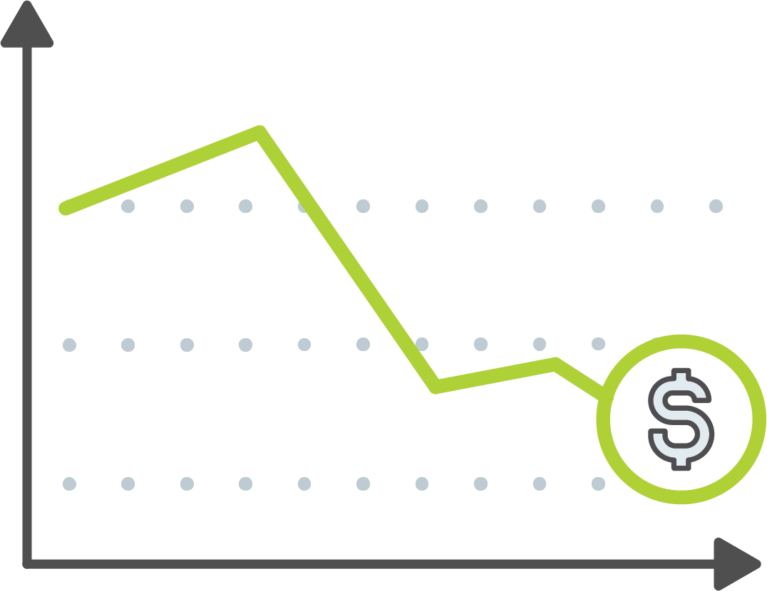

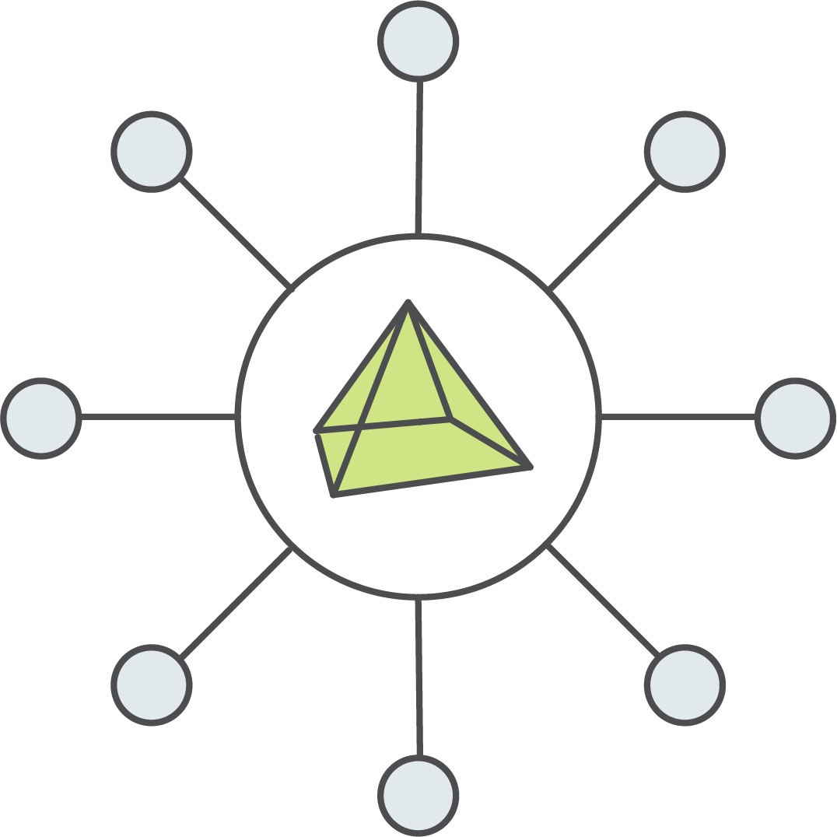

Backup Pain Points
Missing backup windows
Not meeting recovery SLAs
Virtualization and Application awareness
Difficult setup and operations
Data Center Modernization
Licensing and renewals
“Need a PhD to manage”
Management Silos
Disparate management
Specialized Teams
Business Goals
Complexity
Consolidation

Slide 3

Top Areas of Concern for Enterprise Backup
Backup Pain Points
Too complex to manage – 41%
Cost is too high – 45%
Backup up Speed is too slow – 37%
Restore Speed is too slow – 44%
Backup success rate below 90% - (14%)
*Gartner IT Infrastructure, Operations Management & Data Center Conference 2016
Notes:
References all the things that Nutanix Mine addresses
Complexity
Performance
TCO

Slide 4


Traditional Backup Environments Are Complex
Legacy Backup Infrastructure
VROps / VCOps
Backup Orchestration and Management
Virtualization Management
Backup Orchestration UI
App Servers
Backup Server
Data Movers
App
Server
Data
Movers
Backup
Server
Siloed Management Stacks
Virtualization
Virtualization
Virtualization
Complex Backup Application Stacks
Compute
Compute
Compute
Inefficient Storage Sprawl
Storage Controller
Storage Controller
Storage Controller
Storage Controller
Storage Controller
Storage Controller
Storage Network
Storage
Dedupe Storage
S3 Storage
Tape

Slide 5
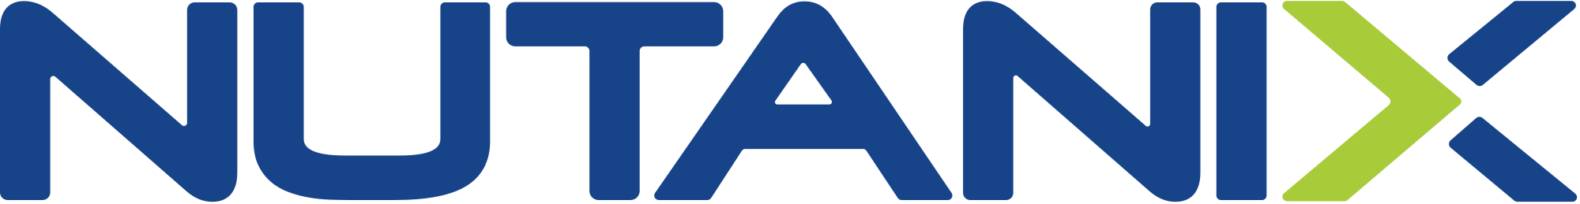

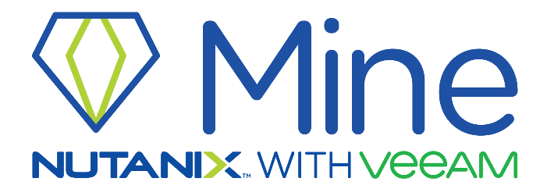
Simplified and harmonized datacenter operations for the multi-cloud era
The most trusted provider of Backup solutions
that deliver Cloud Data Management
Market Leader for HCI
Recognized Hyperconverged Infrastructure leader by Gartner and Forrester
One-Click Simplicity
Consumer-grade management of datacenter infrastructure and applications eliminates the need for specialized IT teams
Freedom of Choice/Run
The performance, resiliency and scalability to power any application workload
Rapid Time to Value
Quick deployment provides means you can deploy your application in minutes
Market Leader for data protection
Recognized backup and recovery leader by Gartner, IDC and Ovum
Simple
Bring together all your data in one place so you can put it to work
Data protection of any workload
Our platform gives our customers Agility, Availability and Business Acceleration
Reliable Customer Value
“It just works” reliability and a Net Promoter Score of 76 - x3 the industry average.
Notes:
Because it make sense and the market is asking for better solutions!
Two leaders working closely together for their customers
Solution Synergies! Data protection and storage must work closely together
IT efficiency gains with integrated IT operations
Cloud-like scaling where ever you need it
Elevate user experience from POC to productivity

Slide 6



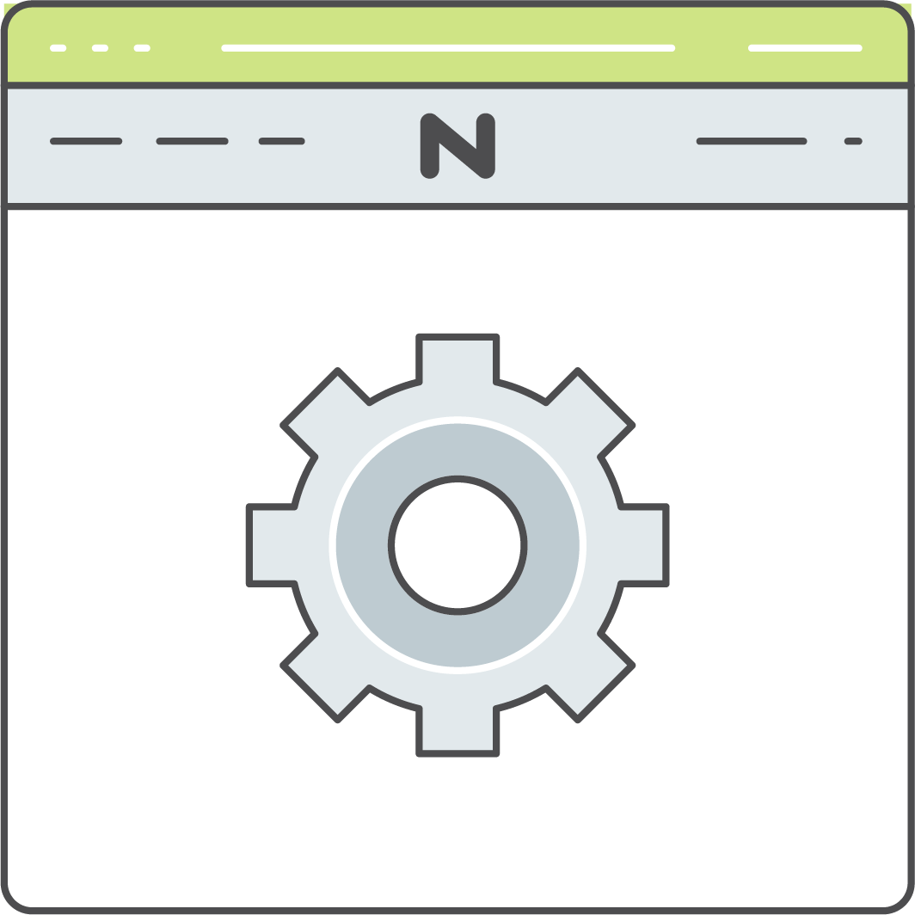

Nutanix Mine with Veeam
For system admins responsible for uptime and recovery SLAs of mission critical applications and data...
…Nutanix Mine with Veeam deploys Veeam Cloud Data Management integrated with Nutanix storage management for a solution that reduces the time and complexity of data protection across the data center and the cloud.
Fast Time to Value
Better customer experience for ordering, deployment, sizing, management, scaling, agility and support. Deploys in under two hours.
Unified IT Operations
Integrated management operations from deployment to day-to-day data management. Eliminates overhead.
Drop In, Scale Out
Full-stack hypervisor, hardware, platform OS, management, storage. Drops into your existing environment to deliver cloud-like scaling.
Notes:
Move up

Slide 7
Value Proposition for Customers
Customers are challenged by the growing variation and complexity of options for assembling a solution for the data center.
Nutanix Mine with Veeam solves this:
Pre-built, Pre-tested, Pre-certified dedicated backup solution
Two “right sized” form factors to suit the majority of use cases
Ability to easily scale both form factors to fit business needs
Quoting and configuration streamlined into primary environment sizing
Sold as a single SKU, single PO for ease of procurement
Notes:
Nutanix Mine with Veeam has been designed to shorten the buying cycle and provide consistent, repeatable performance from a backup solution. Nutanix Mine with Veeam comes pre-sized and tuned to optimal backup performance by the experts at Nutanix and Veeam. The setup experience is automated on behalf of the partner and/or customer which allows this solution to be quickly spun up during PoC or production deployment scenarios alike. The two starting form factors are aimed to satisfy the majority of commercial to enterprise customers, with the ability to seamlessly add additional nodes to scale the solution into larger organizations. The Nutanix Mine with Veeam solution is configured and sold as a single SKU to the customer, providing them with a single price for ease of sale.

Slide 8
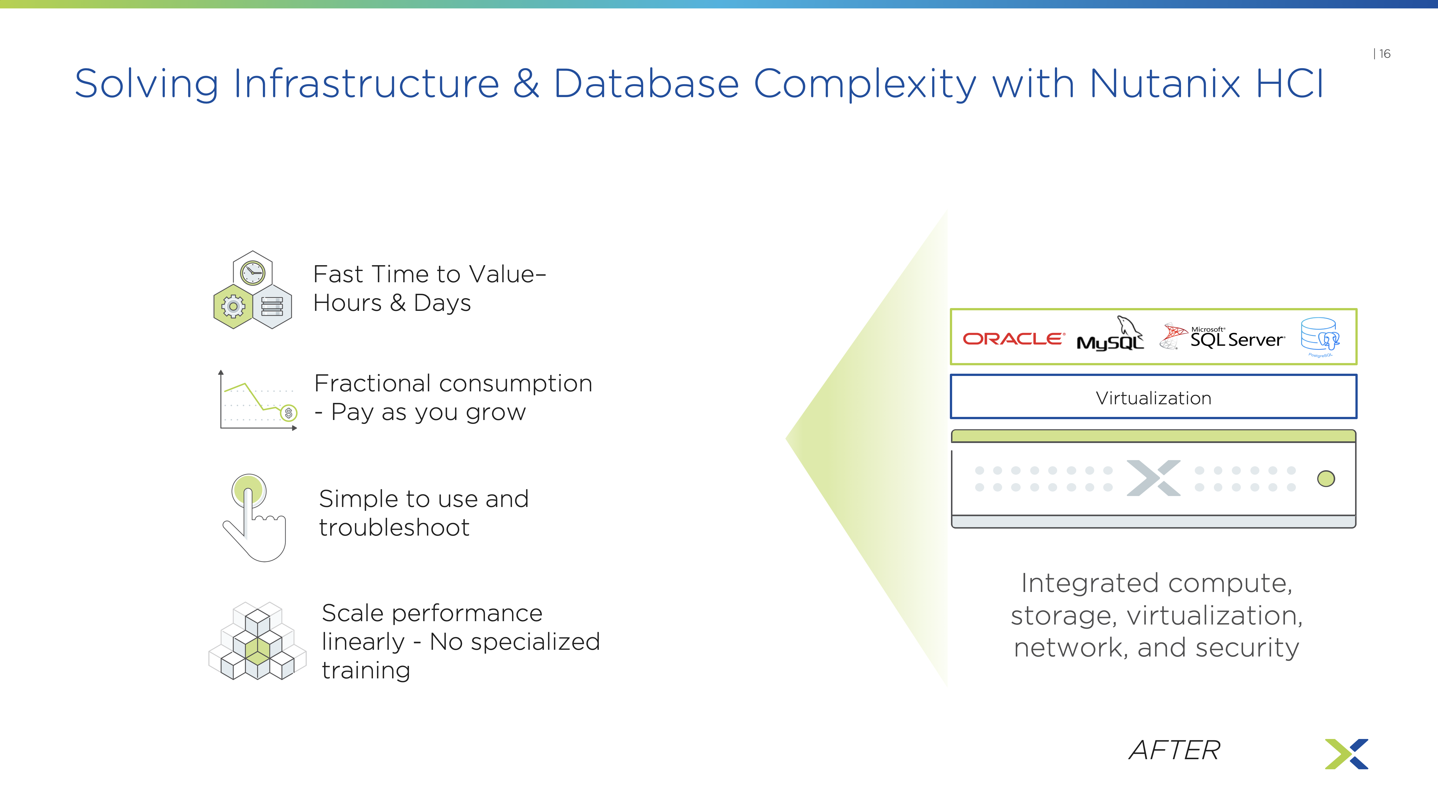
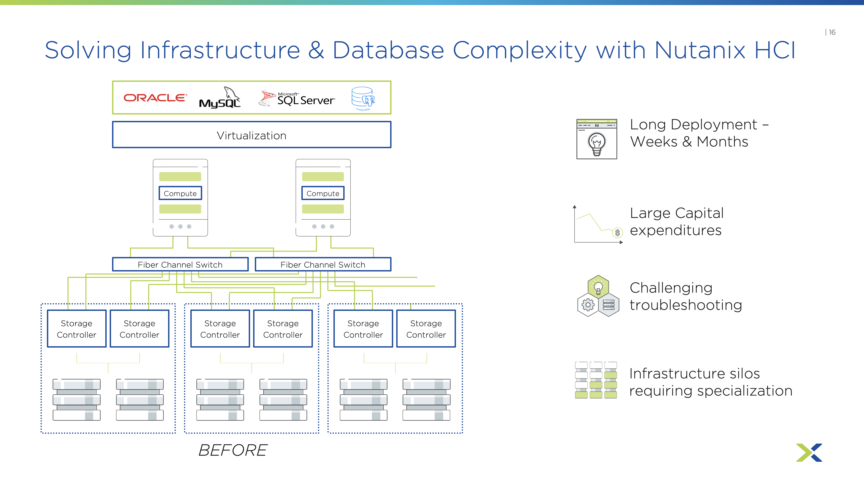
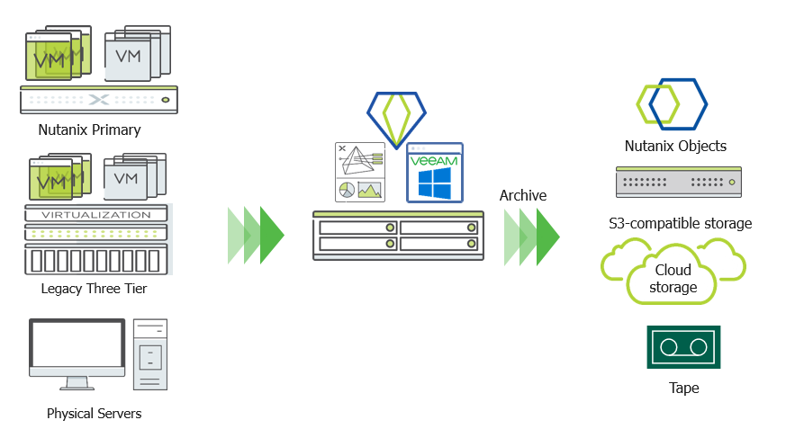
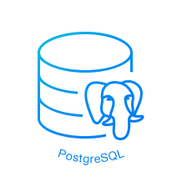


Nutanix Mine with Veeam Architecture
@Sales Reviewers: please use Presentation Mode to follow animation flow/story – we will clean it up so as not to look so busy
Single Management UI - Prism
Fast Time to Value– Hours & Days
Fractional consumption - Pay as you grow
Virtualization
Simple to use and troubleshoot
Integrated compute, storage, virtualization, network, and security
Scale performance linearly - No specialized training
Extended Data Fabric
AFTER
Notes:
The platform will be delivered as a solution and allows customers to choose some of our software-only data protection vendors that are participating actively in the Nutanix Ready Alliance Partner program.
To solve all the challenges outlined above – we are introducing Nutanix Mine
With Nutanix Mine we are extending our core strengths of Nutanix AOS software that we have built for the past ten years, to the secondary space. It integrates with data protection software from Veeam and HYCU, so their software runs in a hyper-converged manner on Nutanix core AOS. So it’s an entirely self-sufficient, turn-key solution, providing compute, memory and storage and now backup. Mine is tightly integrated with Nutanix’s HCI data fabric and advanced Prism management console. That means, for the first time, datacenter managers can rely on a single pane of glass to manage their primary storage as part of the HCI infrastructure, as well their secondary storage for data back-up
Click →
Nutanix Mine can backup VMs and Application data from both Nutanix as well as Non-Nutanix Environments. This opens-up a lot of green-field opportunities for us to position Mine as a standalone backup solution even in legacy environments.
The winning proposition here is that we are - Marrying the best HCI solution and backup capabilities of leading backup partners to create a modern and efficient backup solution.

Slide 9
Nutanix Mine with Veeam
Nutanix AOS
for Mine
Mine Small
or
Mine Medium
Veeam Backup &
Replication™
Enterprise Plus
Frequently Asked Question: What happens if the customer already has existing Veeam licenses?
The Veeam licenses are Veeam Universal Licensing, Enterprise Plus level – Veeam’s highest licensing tier
Customer can transfer their existing Veeam licenses to the Nutanix Mine with Veeam solution i.e. There will be an option to purchase the Nutanix Mine solution without Veeam licenses.
Nutanix Mine
with Veeam
Windows Server
2019
Completely Automated Install & Configuration
“Veeam”
Ubuntu Linux
Full Nutanix &
Veeam
Support
Entitlements

Slide 10
Platform Integration
Nutanix Sizer Support
Day -2
Size
Single Throat to Choke
Simplified SKUs
Day n
Support
Day -1
Procure
Data Protection Software
+
Nutanix Appliance
Day n
Scale
Day 0
Deploy
Solution Scale-out
Day 1
Use
Up & Running in Minutes
Optimized for
Backup & Infra Admins

Slide 11
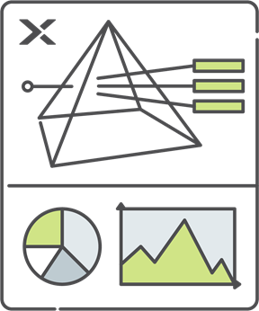



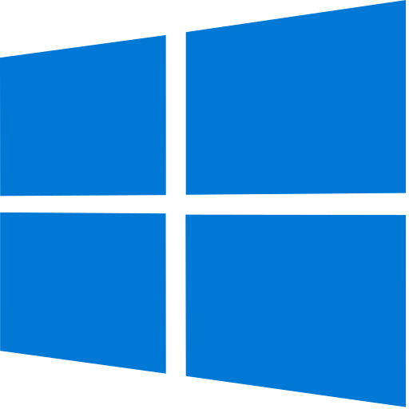


Nutanix Mine with Veeam Configurations
 | Small Nutanix NX-1465-G7 | Medium Nutanix NX-8235-G7 x2 | Expansion Nodes Nutanix NX-8235-G7 x1
Rack Size | 2U | 4U (2 x 2U) | 2U
SSD (per node) | 1x 1.92 TB | 2x 1.92 TB | 2x 1.92 TB
HDD (per node) | 2x 12 TB | 4x 12 TB | 4x 12 TB
Usable Capacity (total) | 70-100 TB | 140-200 TB | 70-100 TB
Veeam Licenses* | 0 or 250 | 0 or 500 | 0 or 250
* Existing Veeam Universal License holders can transfer their existing licenses to Nutanix Mine with Veeam at no cost
Notes:
Customer can “seed” their Mine cluster w/either the “Small” or “Medium” starting point
Compute/storage scale out with 2U/2 node system(s) only regardless of initial “Small” or “Medium” configuration
Expect a 35-50% blended discount off list
NOTE: only showing raw capacity. Nutanix RF, erasure coding, etc. will significantly affect usable capacity (note Nutanix sizing status later in PPT)
Nutanix field has already requested an “Extra-Small” form factor which would likely be the 1465-G7 w/8TB drives yielding 64 TB raw. No determination has yet been made on whether this will be made available.

Slide 12
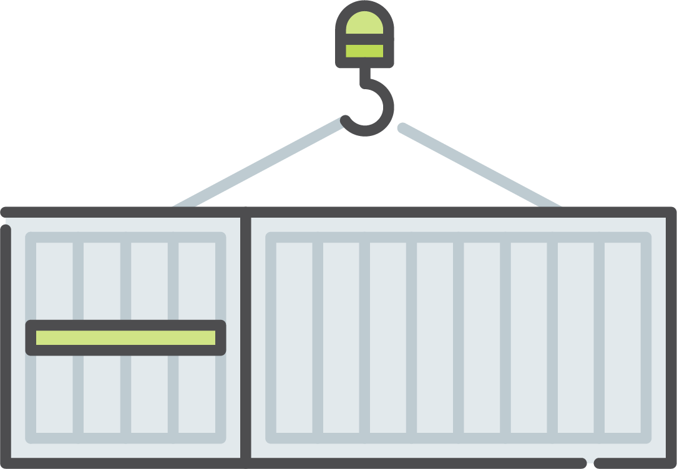

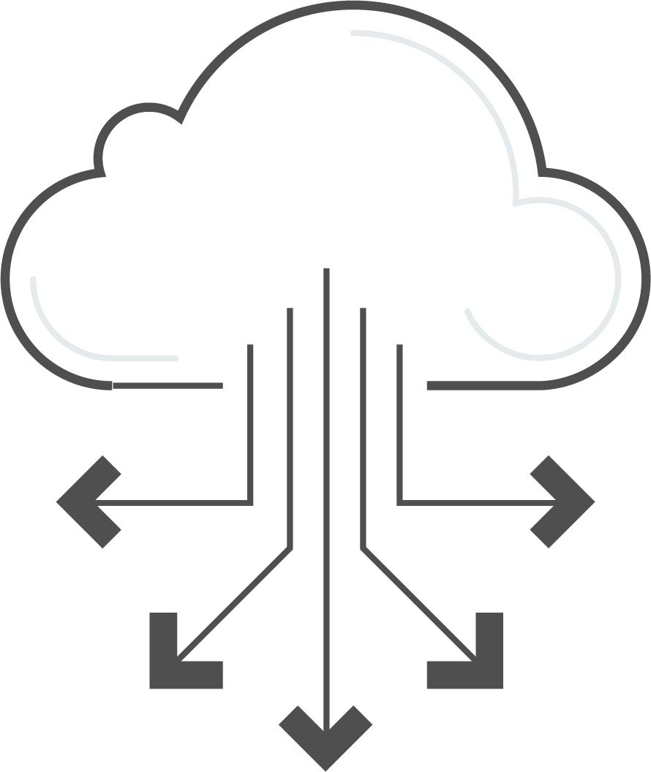
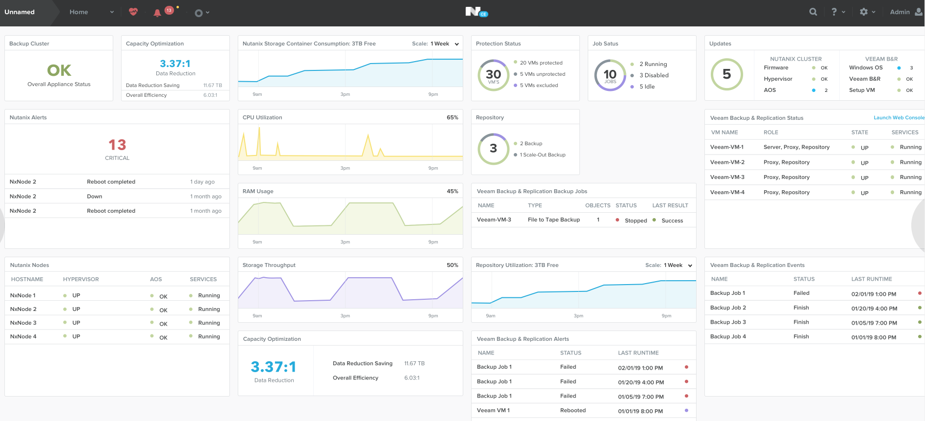




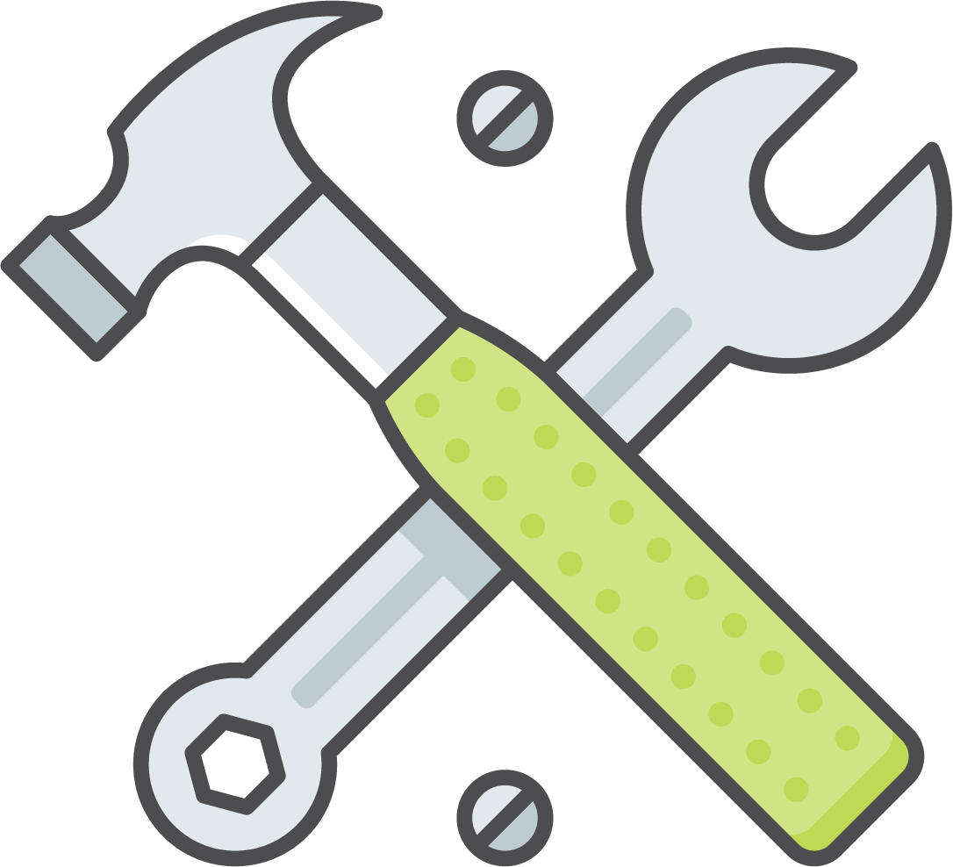
Ease of Procurement & Deployment
<2 hrs
Customer receives standard NX appliance. Rack&Stack followed by Foundation to deploy AOS
Download & Run Foundation for Mine to deploy and configure Veeam software stack through a wizard-based workflow
Customer logs into Prism to leverage Mine dashboard and launch Veeam VBR
Supported by Nutanix and Veeam

Slide 13
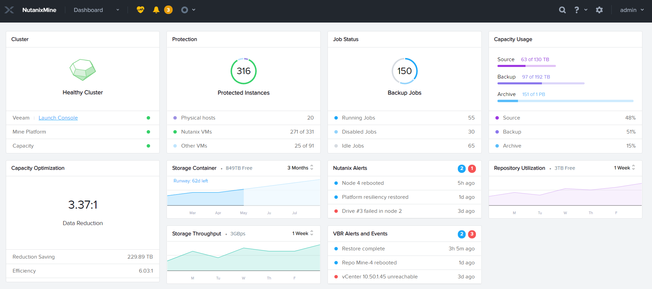
Nutanix Mine with Veeam Dashboard

Slide 14


Customer Quotes…
Our testing of Nutanix Mine with Veeam shows significant performance improvements over our current environment. Proven scalability, and the flexibility to grow with our increasing business needs, is critical for us. This ensures we have the right backup and disaster recovery infrastructure in place protecting our data on a consistent and reliable basis
Sean Gilliam
Our customers depend on us for solutions that help them quickly scale up infrastructure to meet increasing availability demands, without the complexity and drain of additional IT overhead, Nutanix Mine with Veeam runs like a champ. It brings everything together in a single simple HCI product that quickly deploys into any environment. We can go from proposal, to planning, and into production very quickly with a proven solution for integrated cloud data management
Chris Hippensteel
Notes:
Ameritas Life Insurance Corp. is a mutual insurance company. It is owned by Ameritas Mutual Holding Company, headquartered in Lincoln, Nebraska, United States.
NRC: Consulting talent gateway for technology solutions, Milwaukee

Slide 15
Availability
Nutanix Mine with Veeam will be available in the following countries. Additional countries and geos will follow:
United States
Canada
Germany
United Kingdom
Italy
France
Switzerland
United Arab Emirates
Nutanix Mine with Veeam will be offered on Nutanix’s NX appliance models
Alternative hardware platforms (ex. HPE, Lenovo) will be available at a later date
Notes:
Nutanix Mine with Veeam will be available through the following distributors:
United States (Arrow, Tech Data, Ingram)
Canada (Ingram, Arrow)
Germany (Tech Data)
United Kingdom (Arrow, Tech Data)
Italy (ComputerGross, Systematika)
France (Arrow, Tech Data)
Switzerland (ALSO)
United Arab Emirates (RedingtonGulf)

Slide 16
Summary
Review of pain points & problems, and how Nutanix Mine with Veeam solves it
AKA Value statement – removes complexity of three-tier backup, simple to deploy, easy to manage, performance scalability, fast time to value, speed & agility, etc.

Slide 17
For More Information
Visit our product pages for data sheets, solutions briefs, and more:
Nutanix: https://www.nutanix.com/products/mine#form
Veeam: https://www.veeam.com/nutanix-backup-solution.html (being updated)
Notes:
Here are a couple of resources to obtain more information about Nutanix Mine with Veeam. Many more resources will be available at GA. To keep informed on the GA timeline and how to order, please go to the “First to Know” pages and sign up.

Slide 18

THANK YOU

